Slide 1


Gymnastics NSW Online Club Induction
How to access training modules

Slide 2
Contents
How to register
Logging in for the first time
How to access the training modules
Ready to GO!
Finished? Now what

Slide 3
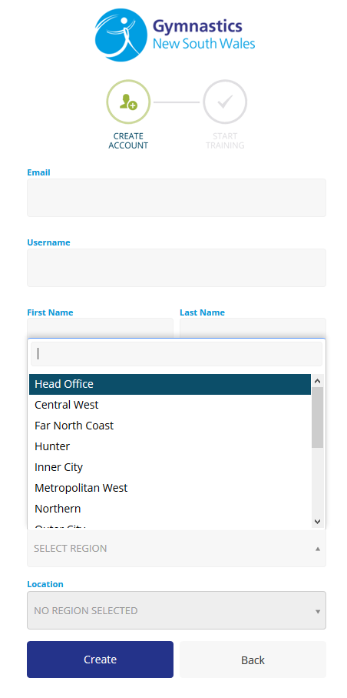
Registering for the Online Induction Training
To self register for the Online Induction Training, please copy and the paste the link below into an internet browser.
https://gymnsw.etrainu.com/training/?event=user.general.register&secret=EC90FF00-DD71-B818-DF56C88EE3016E6E
You will need to select a region from the drop down option, before a list of clubs will show under the ‘Location’ tab.
Contact clubdevelopment@gymnsw.org.au if you are unsure what region the club is located in
Then, check your email as details of your username and password will be sent to your nominated email address you have provided.

Slide 4
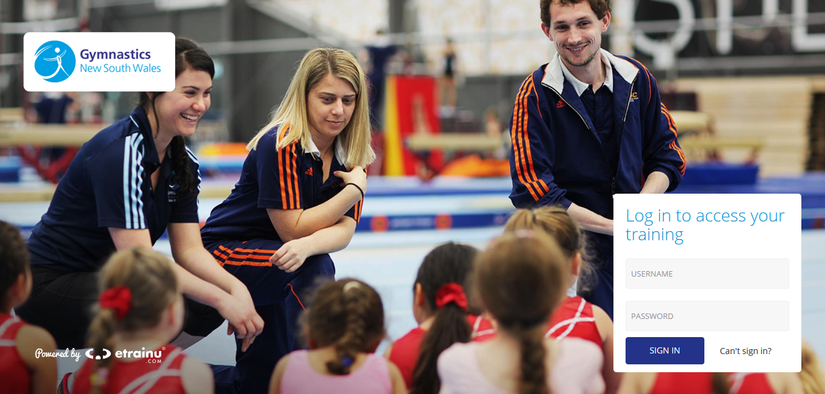
Logging in for the first time
To access your account, copy and paste the link below into your internet browser
http://gymnsw.etrainu.com
Enter your username
and password when prompted

Slide 5
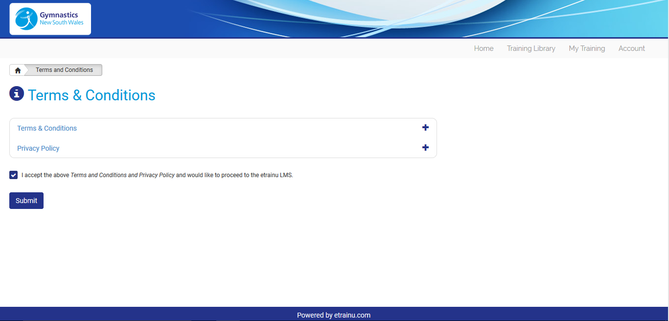
Logging in for the first time
When logging in for the first time you will need to read and accept the ‘Terms and Conditions’ and ‘Privacy Policy’ links

Slide 6
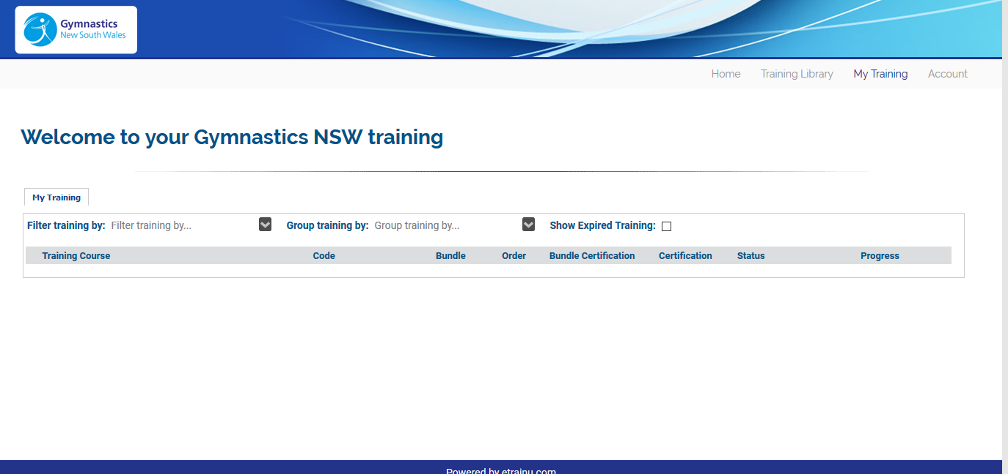
How to access the training modules
Once on the Home Screen,
click ‘Training Library’

Slide 7
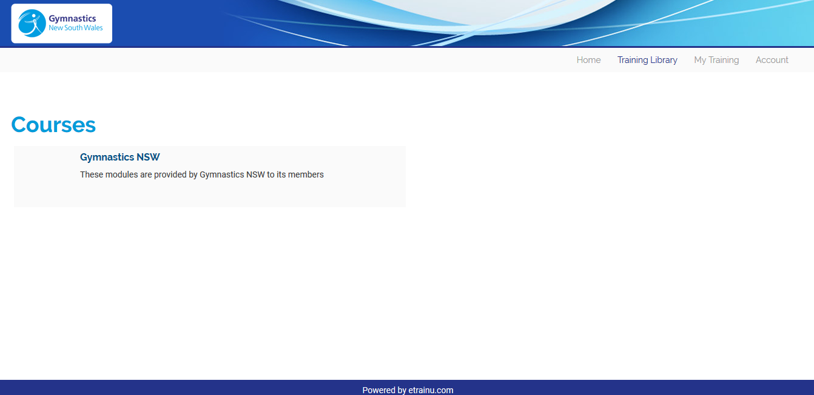
How to access the training modules
Under ‘Courses’ click on ‘Gymnastics NSW’ text

Slide 8
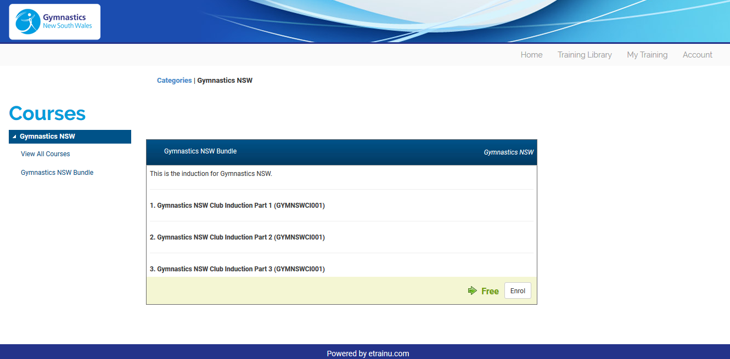
How to access the training modules
Click on ‘Enrol’ to gain instant access to the Club Induction Training Modules

Slide 9
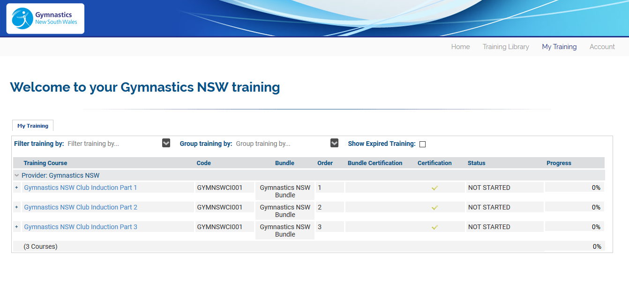
Ready to GO!
Return to your Home Screen and the training modules should now be available
Click on Part 1 to begin!
TIP: Make sure you are using the latest version of Google Chrome when completing the training!

Slide 10
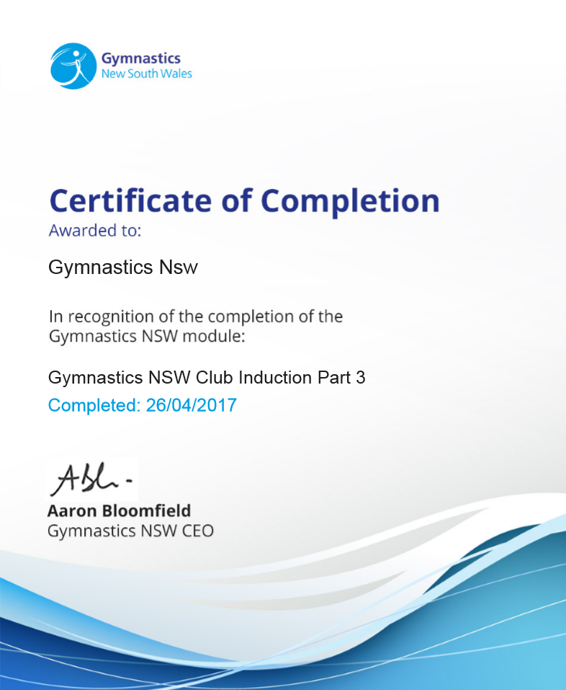
Finished? Now what
Once you have completed all three training modules you will be able to download a certificate of completion.
Remember to provide a copy of this certificate to your club as proof of you doing the training!
2 updating points will also be awarded. Send a copy to coaches@gymnsw.org.au

